Slide 1
4) Conjoint and Discrete Choice (Continued)

Slide 2
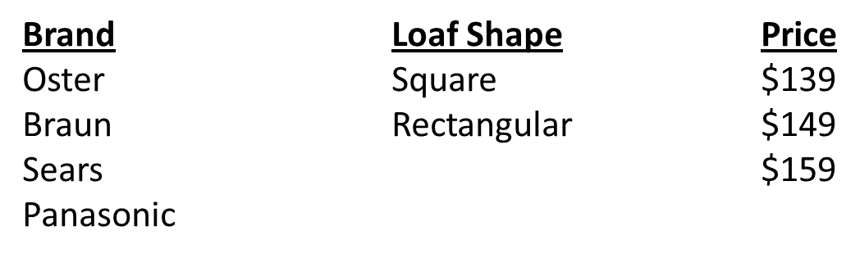
Full Profile Conjoint
Example: Create bread maker design (in fewer than 24 profiles), administer to multiple respondents, and estimate market share.

Slide 5
SAS Program to Estimate Utilities for Multiple Respondents (change items in red as needed)
data bmrsmp; /*Reads design and data into file named bmrsmp */
input brand $ shape $ price $ resp1-resp5; /* Modify variable names to your application */
/* Paste your design and data after "datalines;" */
datalines;
Oster Sqr $149 96 61 85 58 74
Oster Sqr $159 84 38 72 43 64
Oster Rec $139 94 56 22 59 37
Etx.
Pana Rec $159 12 1 12 30 21
;
run;
ods exclude notes anova mvanova;
proc transreg data=bmrsmp utilities short method=morals; /* Performs utility estimation */
model identity(resp:)= class(brand shape price/zero=sum); /* Change "brand shap price" to your application */
output out=results ireplace coefficients;
run;
data sumresults(keep=_name_ &_trgind); /* Creates a summary file of utilities */
set results;
if(_type_='M COEFFI');
run;
proc print data=sumresults;run; /* Prints summary file of utilities */

Slide 6
Output
R-Square 0.9764

Slide 7
Estimation of shares: same concepts as before, but using full profile conjoint utilities

Slide 8
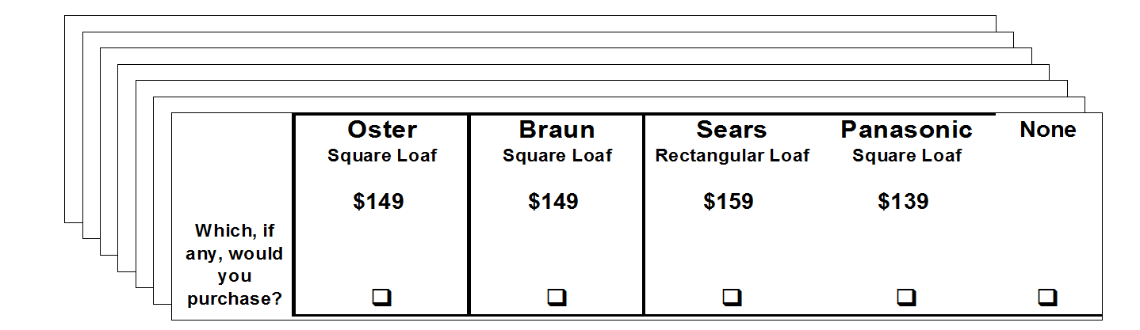
Discrete Choice
Discrete Choice (also referred to as Choice Based Conjoint) has a respondent task where choices are made among sets of profiles, rather than having respondent rate/rank profiles.

Slide 9
Discrete Choice Fundamentals
As with ratings/rankings based conjoint, utilities are estimated based on the respondent task information (DC uses choice information).
Share estimation is performed using choice probability estimates based on the utilities.

Slide 10
Oster
Braun
Sears
Panasonic
None
Square Loaf
Square Loaf
Rectangular Loaf
Square Loaf
$149
$149
$159
$139
Which, if
any, would
you
q
q
q
q
q
purchase?
Profile
Utilities
(generic utility model)
U
Oster
=
β
+
β
+
β
.
O
square
$149
.
.
U
Pana
=
β
+
β
+
β
P
square
$139
Calculate choice probabilities using the utilities and the multinomial logit probability formula.
For Example: Probability of Choosing Oster:
exp(U
Oster
)
exp(U
Oster
) + exp(U
Braun
) + exp(U
Sears
) +
exp(U
Pana
) + exp(U
None
)
where exp(U) = e
U

Slide 12
With the logit model, the associated D-Efficiency measure is more complicated than the linear model D-Efficiency measure used for ratings/rankings based conjoint.
Fortunately, the procedures for linear model design construction and evaluation can be used for choice models as well (surrogate approach).
Questions
How large is the full factorial?
How many choice sets are needed?
How can we produce a design??

Slide 16
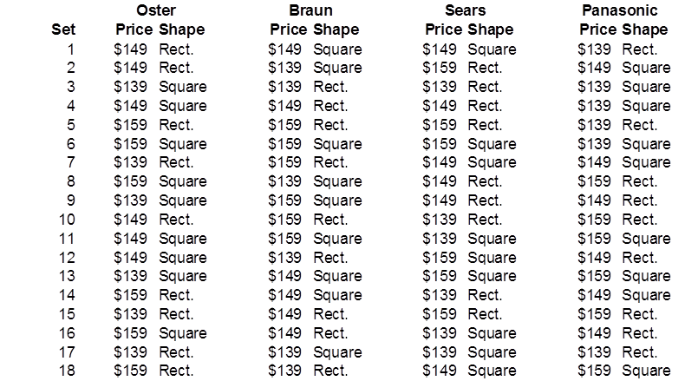
Assigning labels to the resulting design produces the following:

Slide 17
Blocked designs
Designs involving large numbers of choice sets can be blocked.
A blocked design has been broken up so that any one respondent evaluates only a fraction of the design
Example:
The following SAS code is designed to optimally sort our existing 18 card bread maker design into two blocks of size 9.
%mktblock(data=dsn, nblocks=2, factors=x1-x8)

Slide 18
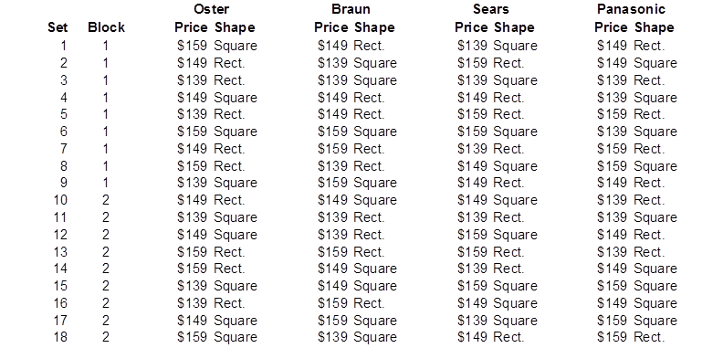
Assigning labels to the result produces the following:

Slide 20
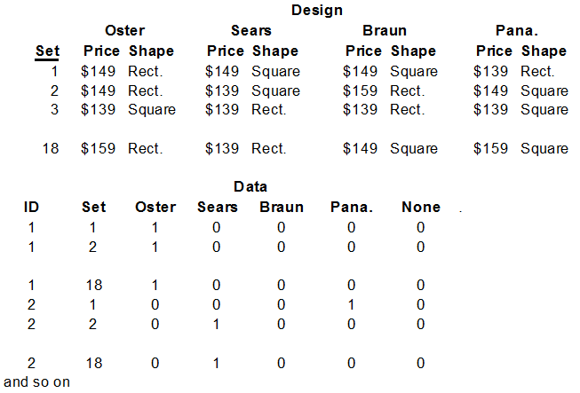
Using the data set consisting of respondent choices, and the coded design matrix, the model parameters (utilities) can be estimated using conventional aggregate modeling methods.
Example of discrete choice responses

Slide 21
In current practice, discrete choice models (also called choice based conjoint) are estimated using hierarchical Bayes (HB) rather than conventional aggregate methods.
HB Enables estimation of a complete set of model components (utilities) for each respondent (individual level) that would not be feasible using conventional methods (individual level models to better capture heterogeneity).
HB involves a hierarchical model structure. Models are estimated using an iterative process involving Bayesian statistical procedures.

Slide 22
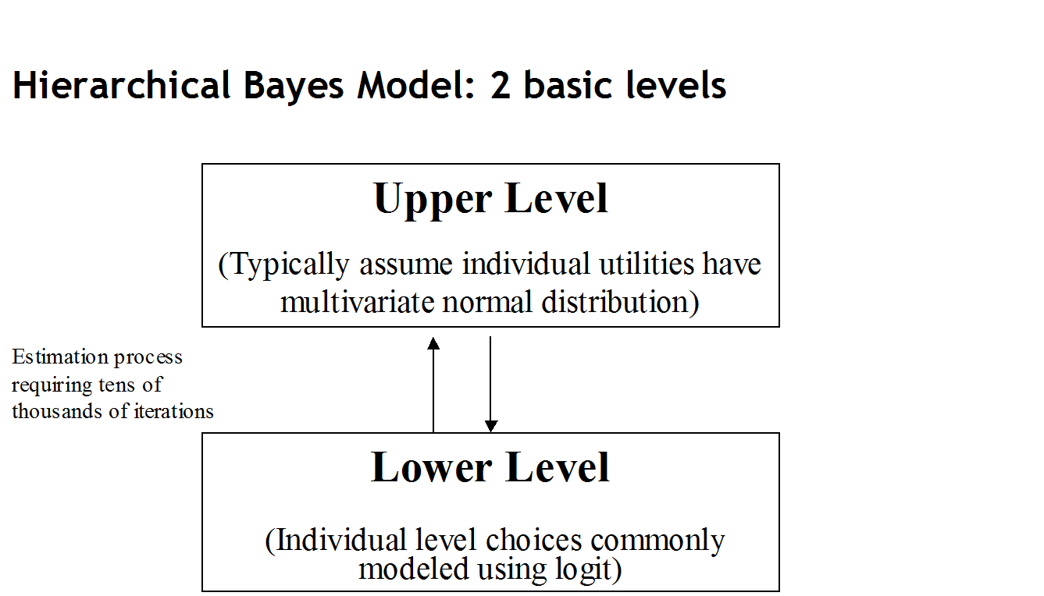

Slide 23
For our breadmaker example we obtained 300 respondents and each provided choices to all 18 choice sets in the design. We are interested in obtaining individual level utility estimates.
In discrete choice, the upper level hierarchical model involves the distribution of the individual model coefficients. These are typically assumed to have a multivariate normal distribution.
β_{i} ~ Normal(α, D)
where β_{i} is the collection of part worths for individual i
α is the collection of means
D is the variance covariance matrix

Slide 24
The lower level model for an individual’s choice probabilities is the multinomial logit.
p_{ik} = exp(x_{k}’ β_{i})/sum(exp(x_{j}’ β_{i}))
The parameters to be estimated are β_{i,} α, and D.
Basically, the procedure works as follows: Using starting values for α, and D, and the choice data, values for β_{i} are generated.
Using the β_{i} values, generate new values for α, and D.
Using the updated values for α, and D generate update values for β_{i}
This procedure is repeated thousands of times until convergence (the parameter estimates stop trending and settle into stable distributions). After convergence, the procedure is run for additional iterations, and the parameter estimates from these additional iterations are commonly averaged to produce the final HB estimates.

Slide 25
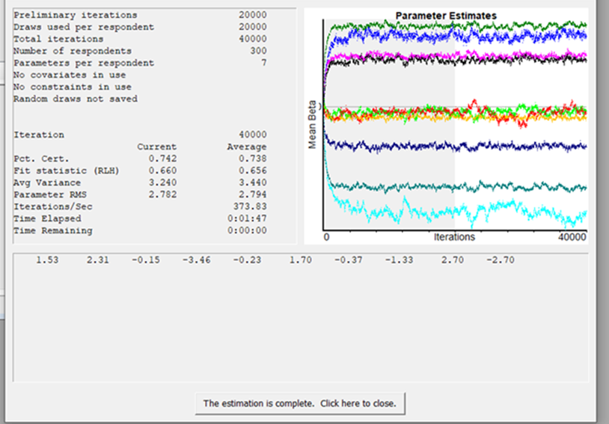
To monitor the process a graph of the mean betas at each iteration (or every kth iteration) is observed. Following is the graph for our bread maker example (produced by Sawtooth software CBC/HB module).

Slide 26
Following are the HB choice utilities for the first 15 respondents

Slide 27
HB Estimation Software:
Sawtooth Software (CBC/HB module)
(Excel file “Bread_Maker_CBC.HB.choice_example.xlsx has the coding, data, and resulting utilities from HB estimation for our bread maker example.
File “BreadMaker_CBC_HB_example.data.csv has the data in a comma delimited format that can be read directly by CBC/HB.)
Bayesm package in the R language (see Bayesian Statistics and Marketing, by P.Rossi, G. Allenby, and R. McCulloch, Wiley)

Slide 28
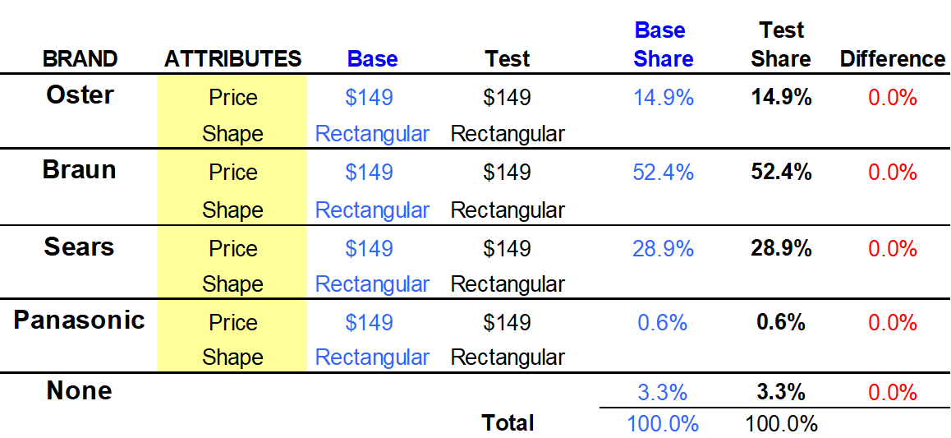
Discrete Choice Market Simulators
As with conjoint, discrete choice simulators facilitate the determination of share estimates for user supplied scenarios.
Features include base case comparisons, product optimizations, and sensitivity analyses.
With individual level utilities, share estimates can be obtained by performing the logit probability calculation for each individual, and averaging the resulting probabilities across respondents.
For our bread maker example (excel file “BreadMaker_CBC.HB.example_simulator.xlsx”)

Slide 29
HB Choice Simulator Share Calculation Illustration

Slide 30
Reading:
“CBC/HB for Beginners”, by J. Howell
http://www.sawtoothsoftware.com/download/techpap/CBCHBbeginners.pdf
For those interested in the Sawtooth CBC/HB estimation program, the manual can be found in the help menu
For those interested in the mathematical details of HB estimation: see Bayesian Data Analysis, Second Edition, by Gelman, A., Carlin, J., Stern, H. and Rubin, D., Chapman & Hall

Slide 31
Added Application 2)
A discrete choice pricing study for canned baked beans was conducted that involved two brands, Bush and Campbell’s, along with a none/other alternative. Only price varied for the two brands. The experiment included 3 prices; $.89, $.99, $1.09.
A sample of 1000 respondents was employed where each respondent made choices for each of the 9 scenarios. Estimation was employed and the utilities are provided in file Topic4_added.app.2.data.xlsx. Using the methods covered in class, estimate share if Bush is priced at $0.89 and Campbell’s is priced at $.99.

